Slide 1
Unit I
continued

Slide 2
Scope of the variable
File Scope
Block Scope
Function Prototype Scope
Function scope

Slide 3
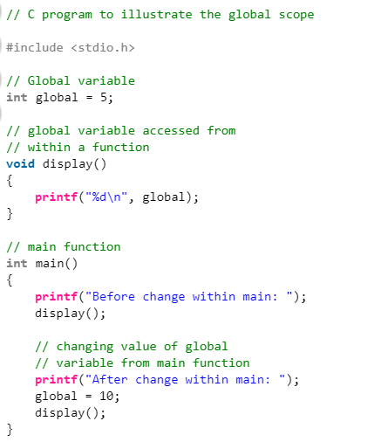
Global Scope

Slide 4
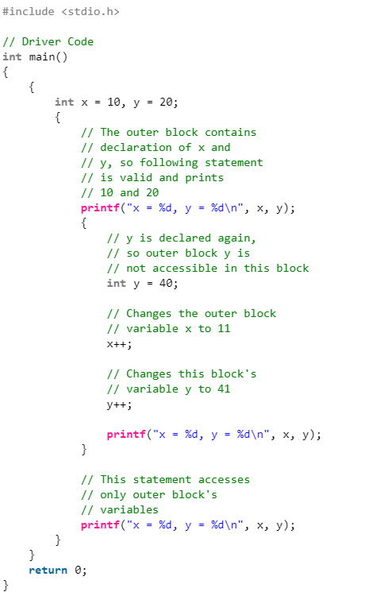
Block Scope

Slide 5
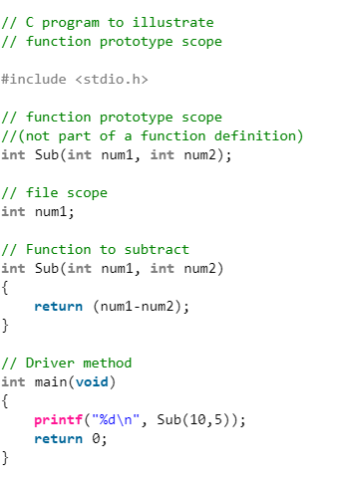
Function prototype Scope

Slide 6
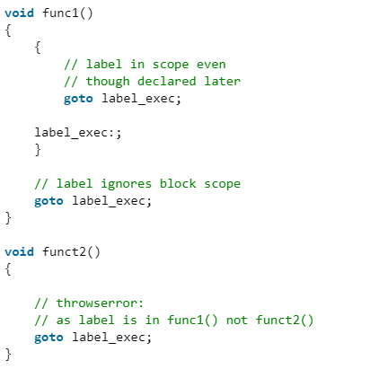
Function scope: Function scope is applicable to labels only

Slide 7
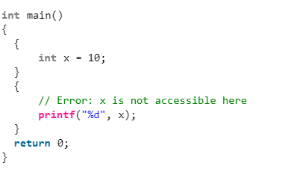

Slide 8
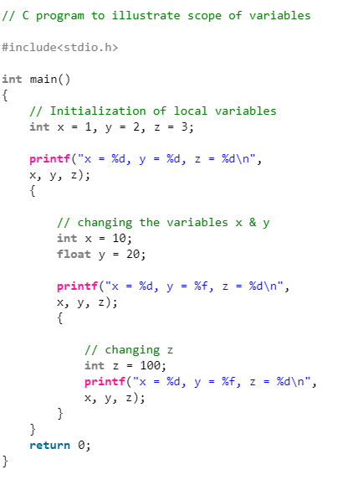

Slide 9
Operators
Unary and Binary operators
Arithmetic Operators (+, -, *, /, %, post-increment, pre-increment, post-decrement, pre-decrement)
Relational Operators (==, !=, >, <, >= & <=) Logical Operators (&&, || and !)
Bitwise Operators (&, |, ^, ~, >> and <<)
Assignment Operators (=, +=, -=, *=, etc)
Other Operators (conditional, comma, sizeof, address, redirection)

Slide 10
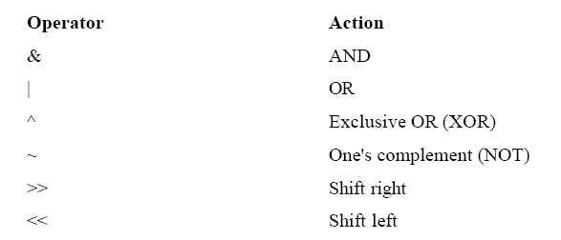
Bit wise operators

Slide 11
The bit-shift operators, >> and <<, move all bits in a variable to the right or left as specified.
The general form of the shift-right statement is variable >> number of bit positions
The general form of the shift-left statement is
variable << number of bit positions

Slide 12
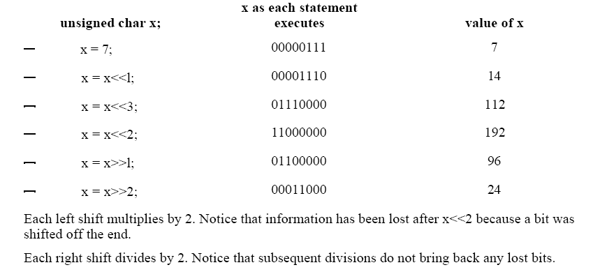

Slide 13
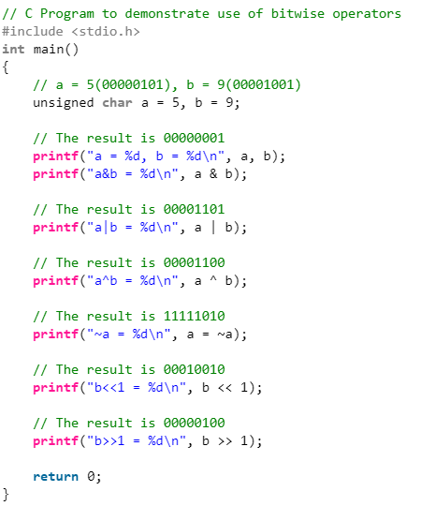

Slide 14
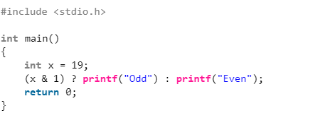
The & operator can be used to quickly check if a number is odd or even.

Slide 15
Points to remember
The left shift and right shift operators should not be used for negative numbers.
The bitwise XOR operator is the most useful operator from technical interview perspective.
The following are many other interesting problems using XOR operator.
Find the Missing Number
swap two numbers without using a temporary variable
A Memory Efficient Doubly Linked List
Find the two non-repeating elements.
Find the two numbers with odd occurences in an unsorted-array.
Add two numbers without using arithmetic operators.
Swap bits in a given number.
Count number of bits to be flipped to convert a to b .
Find the element that appears once.
Detect if two integers have opposite signs.

Slide 16
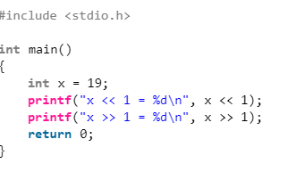
The bitwise operators should not be used in place of logical operators.
The left-shift and right-shift operators are equivalent to multiplication and division by 2 respectively.

Slide 17
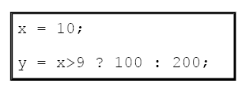
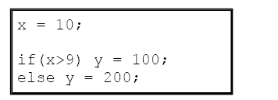
The ? Operator
replaces certain statements of the if-then-else
form
ternary operator ? takes the general form
Exp1 ? Exp2: Exp3;
This is equivalent to next code

Slide 18
The & and * Pointer Operators
The first pointer operator is &, a unary operator that returns the memory address of its operand.
m = &count; → & as meaning ''the address of”
"m receives the address of count.“
A pointer is the memory address of an object. A pointer variable is a variable that is specifically declared to hold a pointer to an object of its specified type
The second pointer operator is *, which is the complement of &. The * is a unary operator that returns the value of the object located at the address that follows it.
q = *m; → * as meaning "at address.“
"q receives the value at address m."

Slide 19
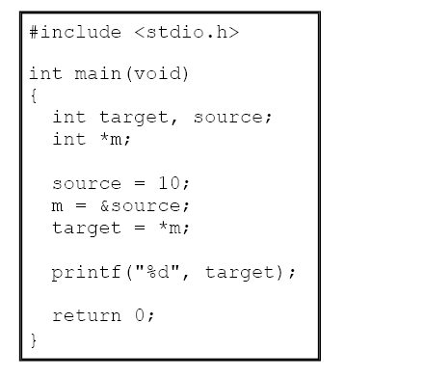

Slide 20
Both & and * have a higher precedence than all other arithmetic operators except the unary minus, with which they share equal precedence

Slide 21
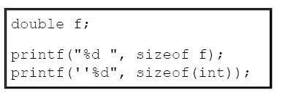
The Compile-Time Operator sizeof

Slide 22

The Comma Operator
first assigns y the value 3 and then assigns x the value 4. The parentheses are necessary because the comma operator has a lower precedence than the assignment operator.

Slide 23
The Dot (.) and Arrow (–>) Operators
the . (dot) and the –> (arrow) operators access individual elements of structures and unions.

Slide 24
The [ ] and ( ) Operators
Parentheses ( ) are operators that increase the precedence of the operations inside them. Square brackets [ ] perform array indexing.

Slide 25
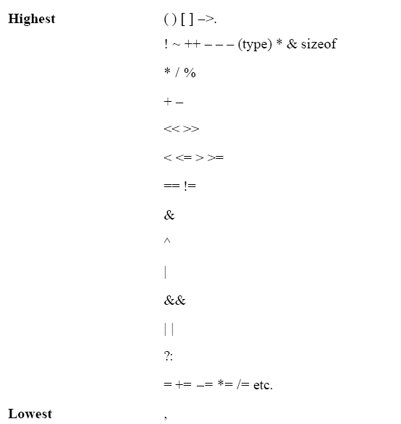
Order of Evaluation - Precedence of C Operators

Slide 26
Type Conversion in Expressions
IF an operand is a long double
THEN the second is converted to long double
ELSE IF an operand is a double
THEN the second is converted to double
ELSE IF an operand is a float
THEN the second is converted to float
ELSE IF an operand is an unsigned long
THEN the second is converted to unsigned long
ELSE IF an operand is long
THEN the second is converted to long
ELSE IF an operand is unsigned int
THEN the second is converted to unsigned int
There is one additional special case: If one operand is long and the other is unsigned int, and if the value of the unsigned int cannot be represented by a long, both operands are converted to unsigned long.

Slide 27
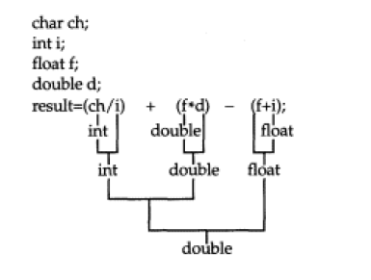
The compiler converts all operands up to the type of the largest operand, which is called type promotion. First, all char and short int values are automatically elevated to int. This process is called integral promotion.

Slide 28

Casts
You can force an expression to be of a specific type by using a cast. The general form of a cast is
(type) expression
where type is a valid data type. For example, to cause the expression x/2 to evaluate to type float, write

Slide 29
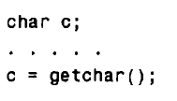

Data Input and Output
getchar, putchar, scanf, printf , gets and puts.

Slide 30
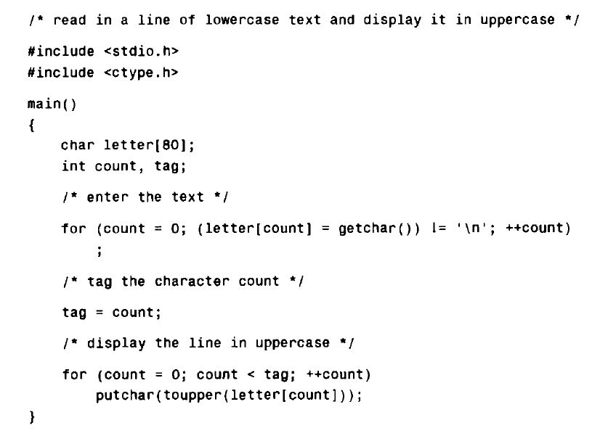

Slide 31
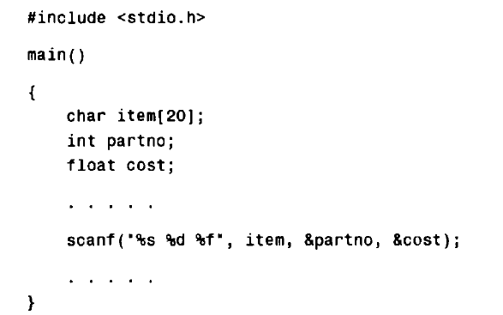

Slide 32
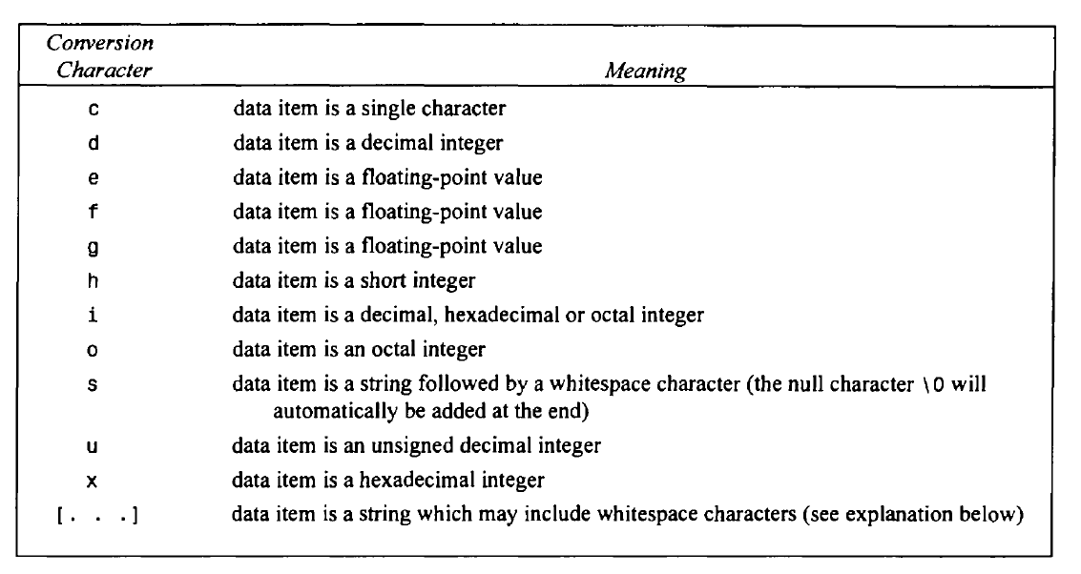

Slide 33
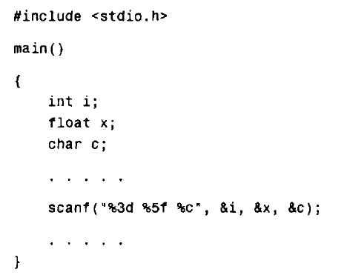
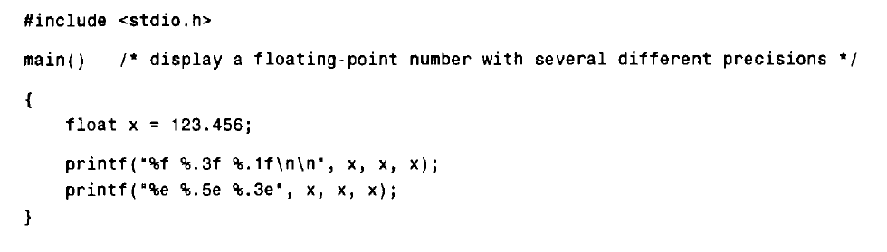
Formatted input and output

Slide 34
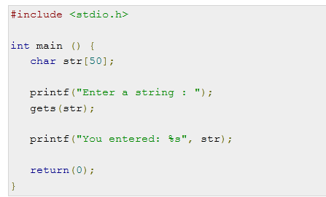
Instead of printf, we can use
puts(str);

Slide 35
Statements
• Selection
• Iteration
• Jump
• Label
• Expression
• Block
True and False in C - In C, true is any nonzero
value, including negative numbers. A false value is 0.

Slide 36
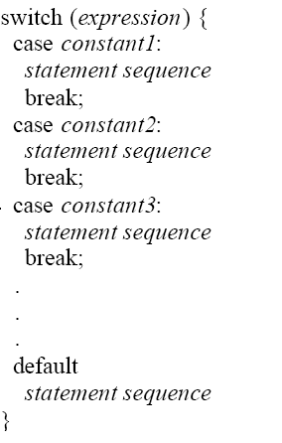
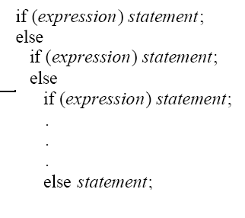

Selection Statements
if and switch

Slide 37
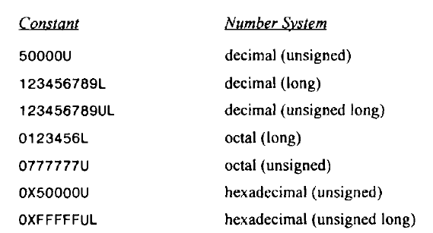
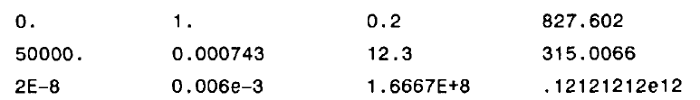
Constants may be int, char, floating-point, string constant

Slide 38
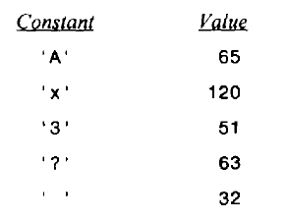
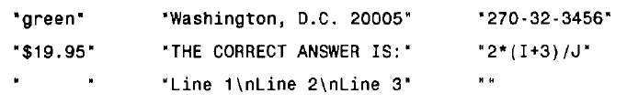

Slide 39
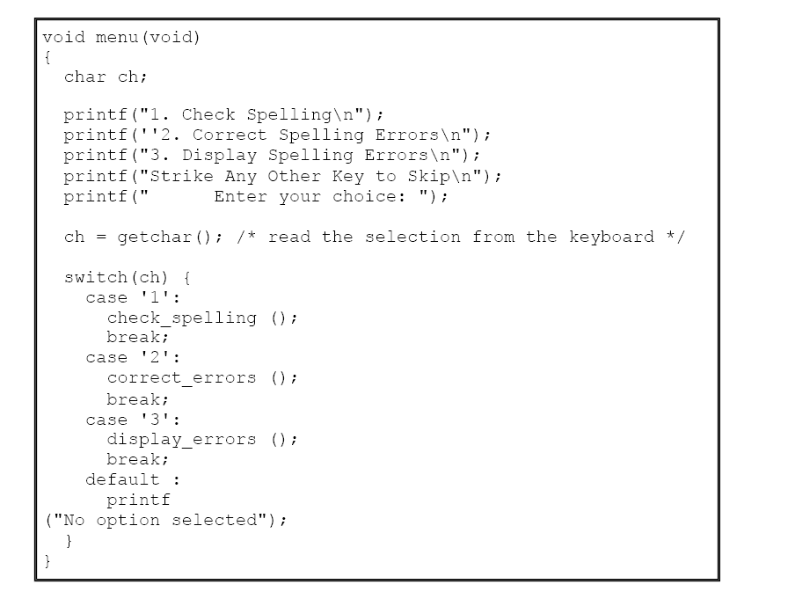

Slide 40
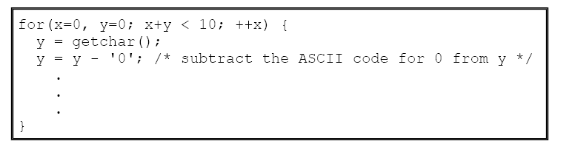
Iteration Statements
The for Loop
#include <stdio.h>
int main(void)
{
int x;
for(x=1; x <= 100; x++)
{
printf("%d ", x);
}
return 0;
}

Slide 41
The while Loop
while(condition) statement;
The do-while Loop
do {
statement;
} while(condition);

Slide 42
Jump Statements
Perform an unconditional branch: return, goto, break, and continue

Slide 43
Block Statements
Block statements are also called compound
statements. A block is begun with a { and terminated by its matching }.

Slide 44
C Program to convert decimal number to binary number
C Program print pascal triangle
C Program to make simple calculator using switch case
C Program to count number of digits in given number
C Program to add two complex numbers

